Slide 1


Versioning control tools
(GIT-GITHUB)

Slide 2
Course Description
This course will teach you about versioning tools , project management and team management.
Course Objectives
Understand what is code versioning?
How important it is ?

Slide 3
Course Contents
Comparing centralized vs. distributed systems
Understand GIT
Create a local repository, create a commit, create a remote repository and push commits to a remote repository.
Git Branching and merging
Git workflow
Use Bitbucket as the hosted provider for remote Git repositories
Learn Git, GitHub, and command-line basics
Deploy sites live up

Slide 4
What is “version control”
Version control is a system that records changes to a file or set of files over time so that you can recall specific versions later
software keeps track of every modification to the code in a special kind of database

Slide 5
WHY WE NEED VERSION CONTROL

Slide 6
BENEFITS OF VERSION CONTROL
Tracking a Project’s History
Sync with multiple computers
Working in a team
Safely create and test new features
Ownership / Credits / Blame

Slide 7
Types of version control systems (VCS)

Slide 8

Local Version Control Systems
Witch mean to copy files into another directory
This approach is very common because it is so simple
it is also incredibly error prone
To deal with this issue, programmers long ago developed local VCSs that had a simple database that kept all the changes to files under revision control.
One of the most popular VCS tools was a system called RCS

Slide 9
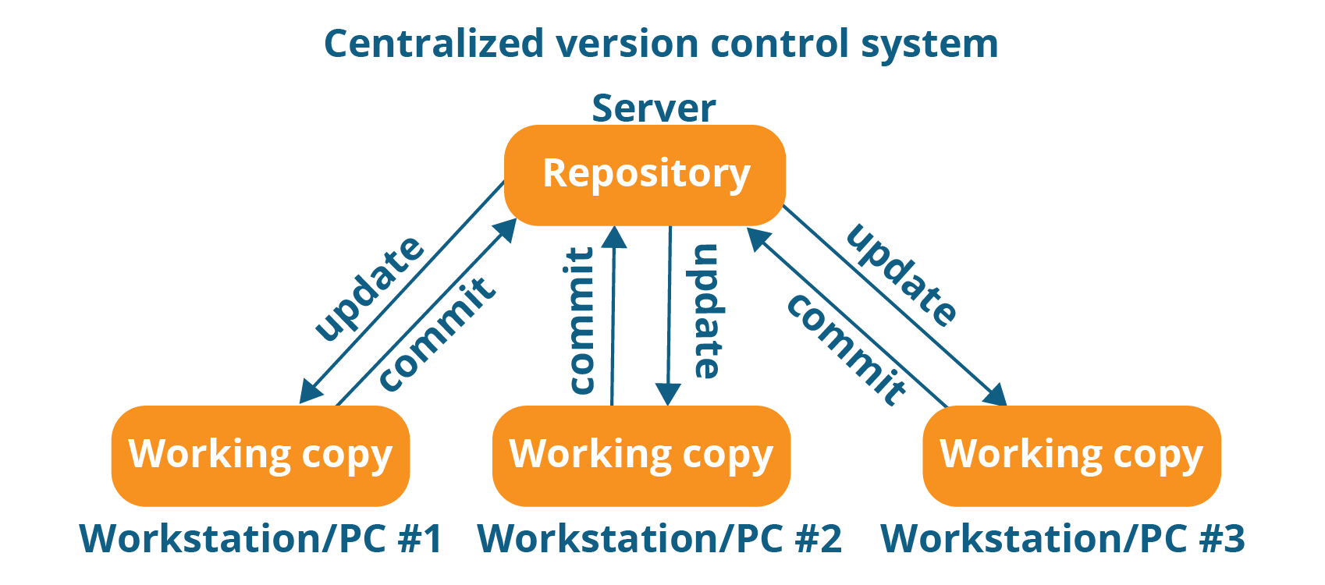


Centralized Version Control
Notes:
Centralized version control systems are based on the idea that there is a single “central” copy of your project somewhere (probably on a server), and programmers will “commit” their changes to this central copy.
“Committing” a change simply means recording the change in the central system. Other programmers can then see this change. They can also pull down the change, and the version control tool will automatically update the contents of any files that were changed.
Some of the most common centralized version control systems you may have heard of or used are, Subversion (or SVN) and Perforce.

Slide 10
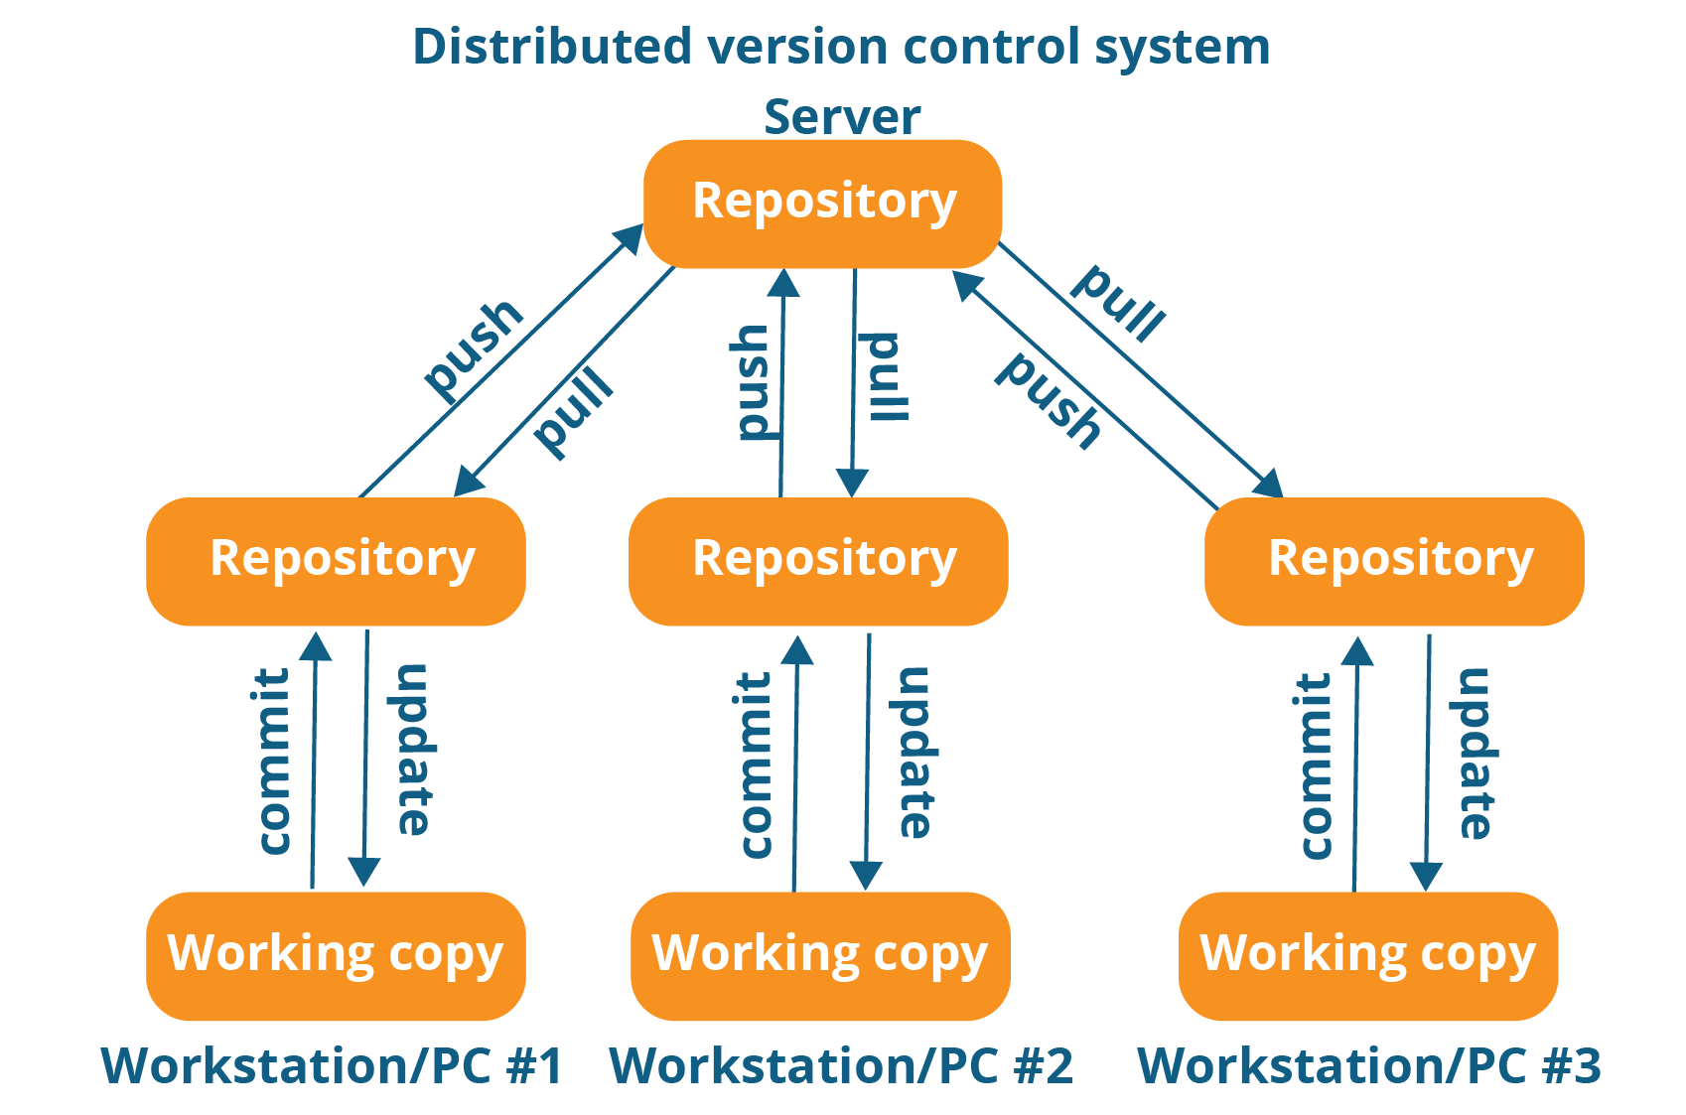

distributed Version Control
Notes:
In distributed version control, every developer “clones” a copy of a repository and has the full history of the project on their own hard drive. This copy (or “clone”) has all of the metadata of the original.
This method may sound wasteful, but in practice, it’s not a problem. Most programming projects consist mostly of plain text files (and maybe a few images), and disk space is so cheap that storing many copies of a file doesn’t create a noticeable dent in a hard drive’s free space. Modern systems also compress the files to use even less space.
The act of getting new changes from a repository is usually called “pulling,” and the act of moving your own changes to a repository is called “pushing”.
One common misconception about distributed version control systems is that there cannot be a central project repository. This is simply not true — in most cases you have one central server which is an authoritative one.
The three most popular of these are Git and Mercurial
Main benefits:
Performance of distributed systems is better
Branching and merging is much easier
With a distributed system, you don’t need to be connected to the network all the time (complete code repository is stored locally on PC)

Slide 12
What git is ???
Distributed Version Control System
Git tracks changes to source code

Slide 13
Advantages of Git
Free and open source
Fast and small
Implicit backup
Security
No need of powerful hardware
Easier branching
Notes:
Advantages of Git
Free and open source
Git is released under GPL’s open source license. It is available freely over the internet. You can use Git to manage property projects without paying a single penny. As it is an open source, you can download its source code and also perform changes according to your requirements.
Fast and small
As most of the operations are performed locally, it gives a huge benefit in terms of speed. Git does not rely on the central server; that is why, there is no need to interact with the remote server for every operation. The core part of Git is written in C, which avoids runtime overheads associated with other high-level languages. Though Git mirrors entire repository, the size of the data on the client side is small. This illustrates the efficiency of Git at compressing and storing data on the client side.
Implicit backup
The chances of losing data are very rare when there are multiple copies of it. Data present on any client side mirrors the repository, hence it can be used in the event of a crash or disk corruption.
Security
Git uses a common cryptographic hash function called secure hash function (SHA1), to name and identify objects within its database. Every file and commit is check-summed and retrieved by its checksum at the time of checkout. It implies that, it is impossible to change file, date, and commit message and any other data from the Git database without knowing Git.
No need of powerful hardware
In case of CVCS, the central server needs to be powerful enough to serve requests of the entire team. For smaller teams, it is not an issue, but as the team size grows, the hardware limitations of the server can be a performance bottleneck. In case of DVCS, developers don’t interact with the server unless they need to push or pull changes. All the heavy lifting happens on the client side, so the server hardware can be very simple indeed.
Easier branching
CVCS uses cheap copy mechanism, If we create a new branch, it will copy all the codes to the new branch, so it is time-consuming and not efficient. Also, deletion and merging of branches in CVCS is complicated and time-consuming. But branch management with Git is very simple. It takes only a few seconds to create, delete, and merge branches

Slide 14
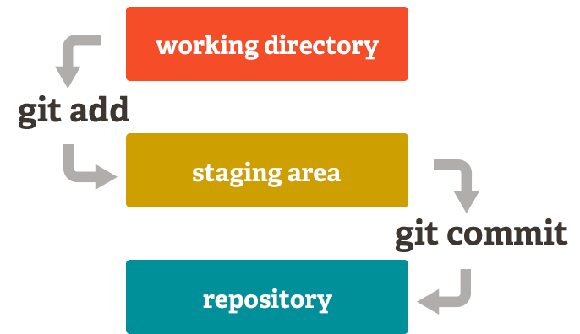
Git workflow

Slide 15
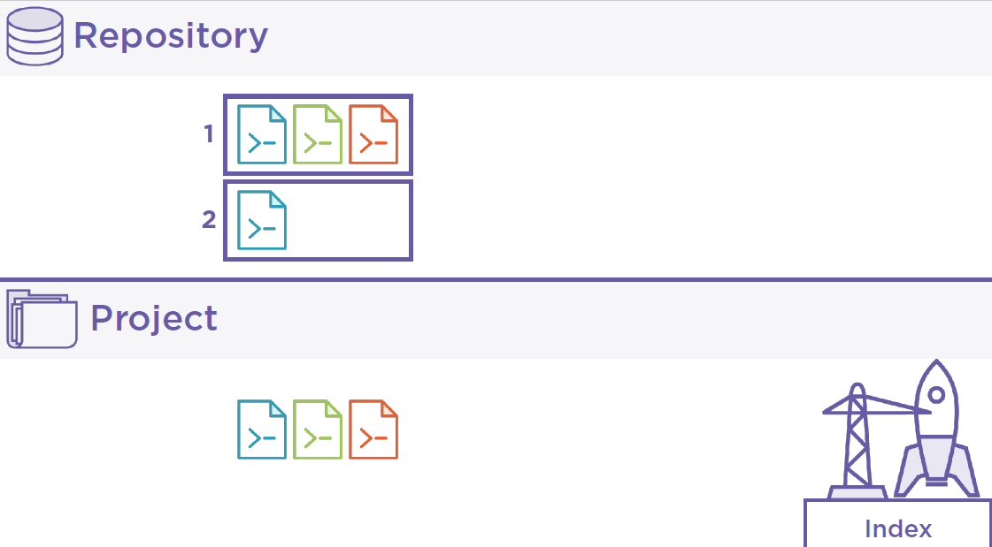
Git workflow
commit
Staging area or index
add
Working directory

Slide 16
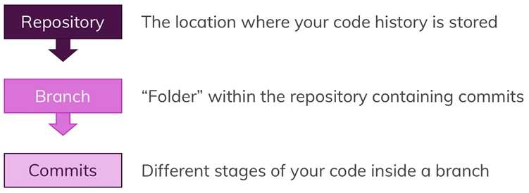
Terminologies

Slide 17
Don’t mix
!==
Git & GitHub are different things

Slide 18
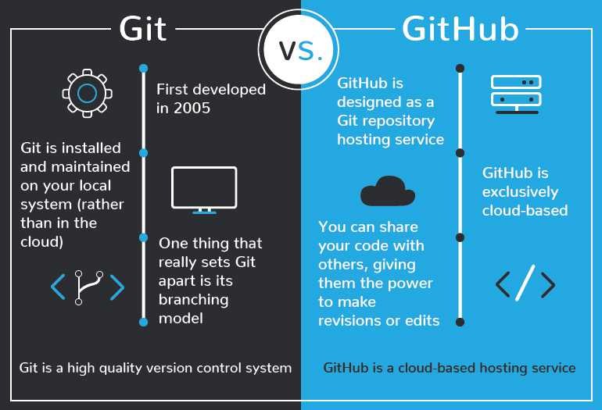

Slide 19
Getting start with git

Slide 20
Installing git
All you need is in stalling git tool from https://git-scm.com/downloads

Slide 21
Demo

Slide 22
Git commands
git init will do all of the initial setup of a repository.
git clone To copy a git repository from remote source, also sets the remote to original source so that you can pull again.
git status To check the status of files you’ve changed in your working directory, i.e, what all has changed since your last commit.
Notes:
$ git clone https://github.com/udacity/course-git-blog-project

Slide 23



git add
add changes to stage/index in your working directory.
Add one file to the stage
Add mor than one file to the stage
Add all files to the stage

Slide 24

git commit
commits your changes and sets it to new commit object for your remote.
-m should provide a meaningful Commit message. In our case we could use git commit -m "added starting code".

Slide 25
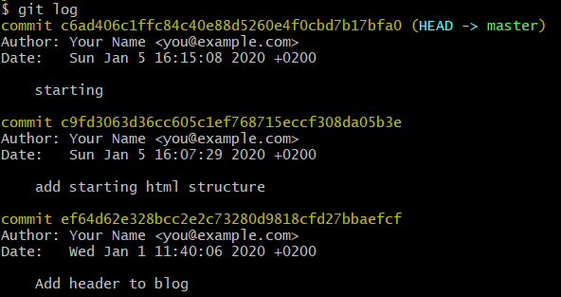
Git log
Entering git log in our terminal will display all Commits inside our Branch:

Slide 26
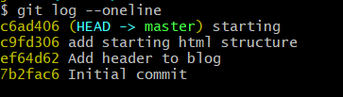
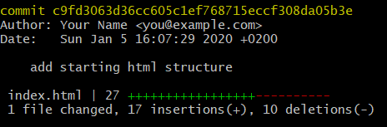
git log --oneline
git log --stat
git log –p

Slide 27
Viewing A Specific Commit
git log fdf5493
git log --oneline fdf5493
git log --stat fdf5493
git log –p fdf5493
git show
The git show command will show only one commit.
the git diff command is used to see changes that have been made but haven't been committed, yet:

Slide 28
Having Git Ignore Files
the .gitignore file is used to tell Git about the files that Git should not track. This file should be placed in the same directory that the .git directory is in.
# Ignore Mac system files
.DS_store
# Ignore node_modules folder
node_modules
# Ignore all text files
*.txt
# Ignore files related to API keys
.env
# Ignore SASS config files
.sass-cache

Slide 29
Tagging
Tags are ref's that point to specific points in Git history.
Tagging is generally used to capture a point in history that is used for a marked version release (i.e. v1.0.1).
Creating a tag :
git tag v1.0
Annotated Tags :
git tag -a v1.0
git tag -a v1.4 -m "my version 1.4"
Tag name

Slide 30
Listing Tags :
git tag
Adding A Tag To A Past Commit
git tag -a v1.0 a87984
Deleting A Tag
git tag -d v1.0

Slide 31
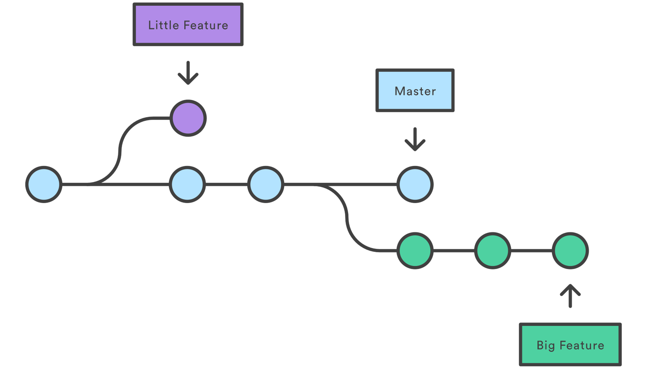
Branching

Slide 32
Branching
A branch represents an independent line of development.
Branches serve as an abstraction for the edit/stage/commit process.
You can think of them as a way to request a brand new working directory,

Slide 33
Branch options
git branch
will list out the branches in a repository:
git branch sidebar
Will create a new branch called sidebar
git checkout sidebar
Switching Branches
git branch –d sidebar
Delete the branch

Slide 34
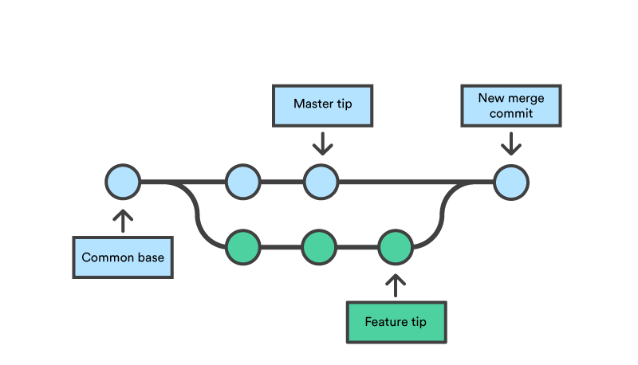
Merging
Merging is Git's way of putting a forked history back together again. The git merge command lets you take the independent lines of development created by git branch and integrate them into a single branch.
Notes:
Note that all of the commands presented merge into the current branch. The current branch will be updated to reflect the merge, but the target branch will be completely unaffected. Again, this means that git merge is often used in conjunction with git checkout for selecting the current branch and git branch -d for deleting the obsolete target branch.

Slide 36
Notes:
https://help.github.com/en/github/using-git/associating-text-editors-with-git
# sets up Git with your name
git config --global user.name "<Your-Full-Name>"
# sets up Git with your email
git config --global user.email "<your-email-address>"
# makes sure that Git output is colored
git config --global color.ui auto
# displays the original state in a conflict
git config --global merge.conflictstyle diff3
git config –list
git config global file - remove settings
https://askubuntu.com/questions/206449/git-config-global-file-remove-settings

